Slide 1

2018·06
Image-completion-with-structure-propagation
Jian Sun Lu Yuan Jiaya Jia Heung-Yeung Shum
张清

Slide 2
Content of the paper
My work
CONTENT
Demo
Improvement and conclusions

Slide 3
Content of the paper

Slide 4
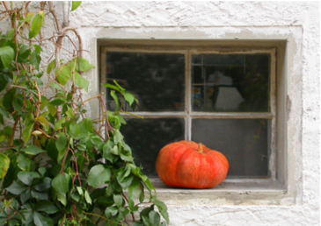
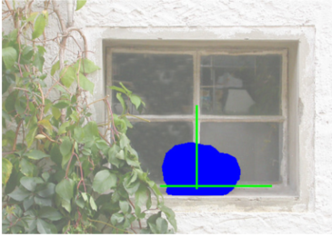
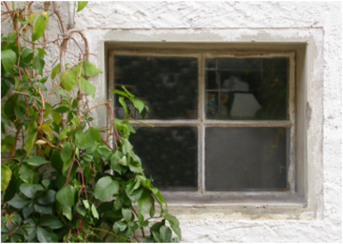
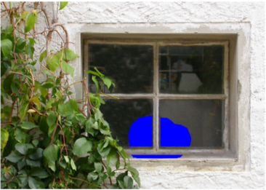
Content of the paper

Slide 5
Content of the paper

⬇

Structure propagation
Texture propagation
Photometric correction
需要用户交互，指定被遮盖区域的结构轮廓和结构来源，之后根据结构信息来源生成传播未知区域的结构信息
在用户的交互下将将整幅图划分为若干个区域，遮挡部分纹理的生成将利用所在区域的纹理来生成
用于填补在遮盖区域之间或是遮盖区域与已知区域之间的patch之间需要做blending处理

Slide 6
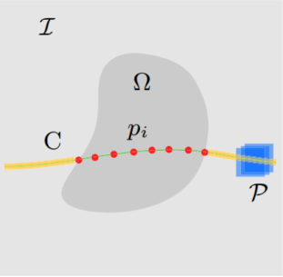
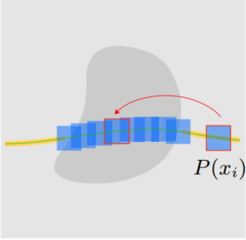
Structure propagation—targets

Slide 7
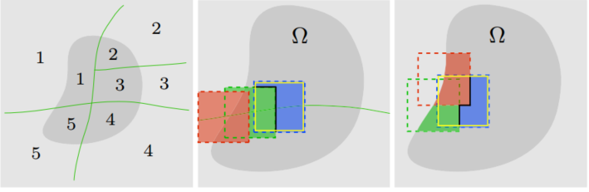
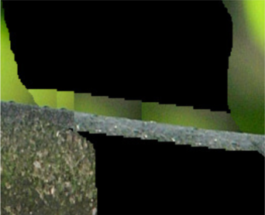

Texture propagation and photometric correction

Slide 8
My work

Slide 9
preparation
Get Curves
Get mask
Partition
Get Anchor points
Math function
Image function

Slide 10
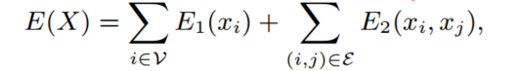
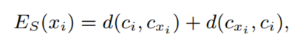
Structure propagation—Minimize Energy
Define the energy:
The algorithm:
1. Dynamic programming
2. Belief propagation

Slide 11
Structure propagation—Minimize Energy
Define the energy:
The algorithm:
1. Dynamic programming
2. Belief propagation

Slide 12
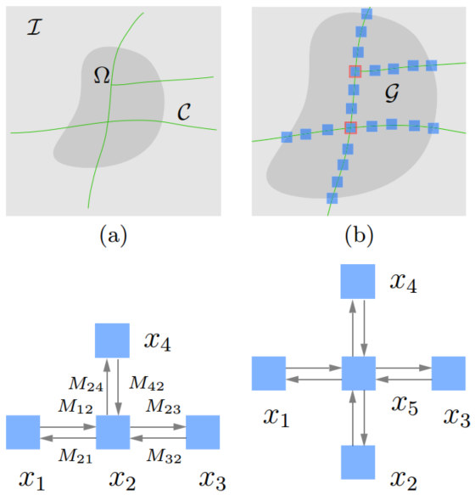
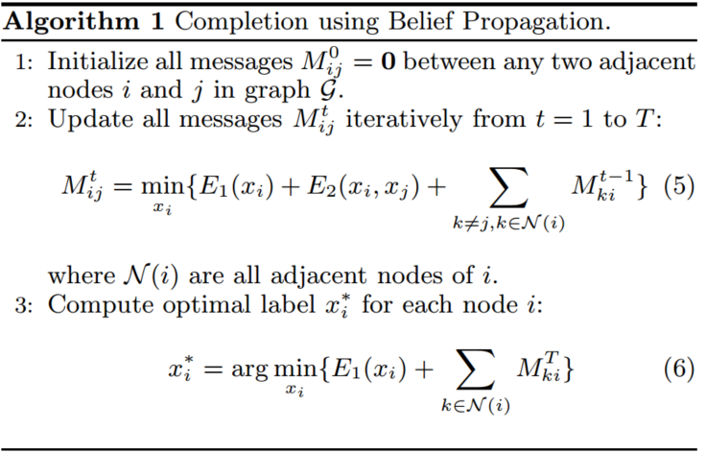
Belief propagation

Slide 13
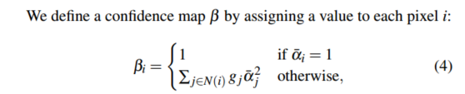

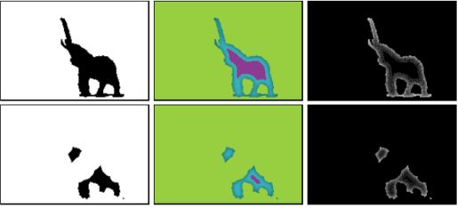
Texture propagation—Confidence map/level map
Define the confidence map:
Define the level map:

Slide 14
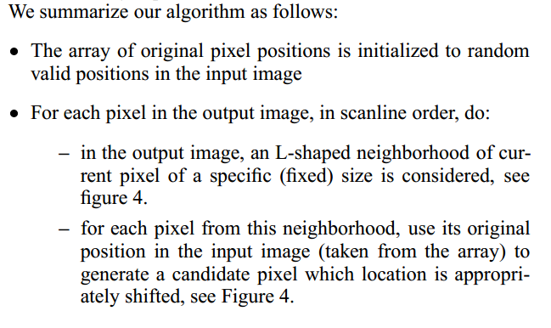
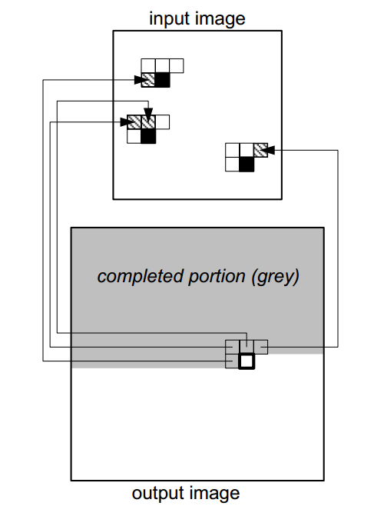
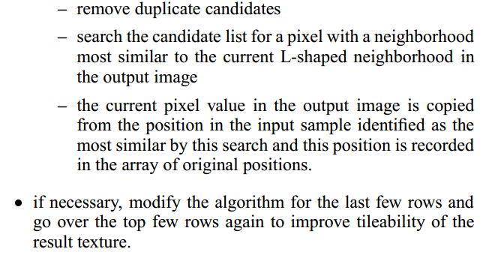
Texture propagation—texture synthesis

Slide 15
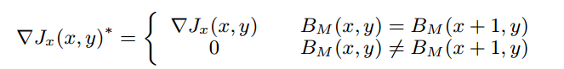
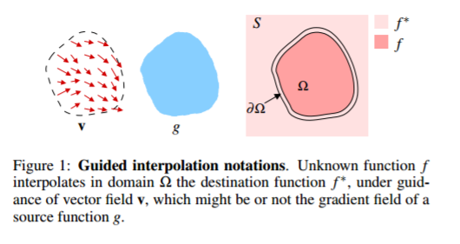
Photometric correction—Poisson function

Slide 16
Demo

Slide 17
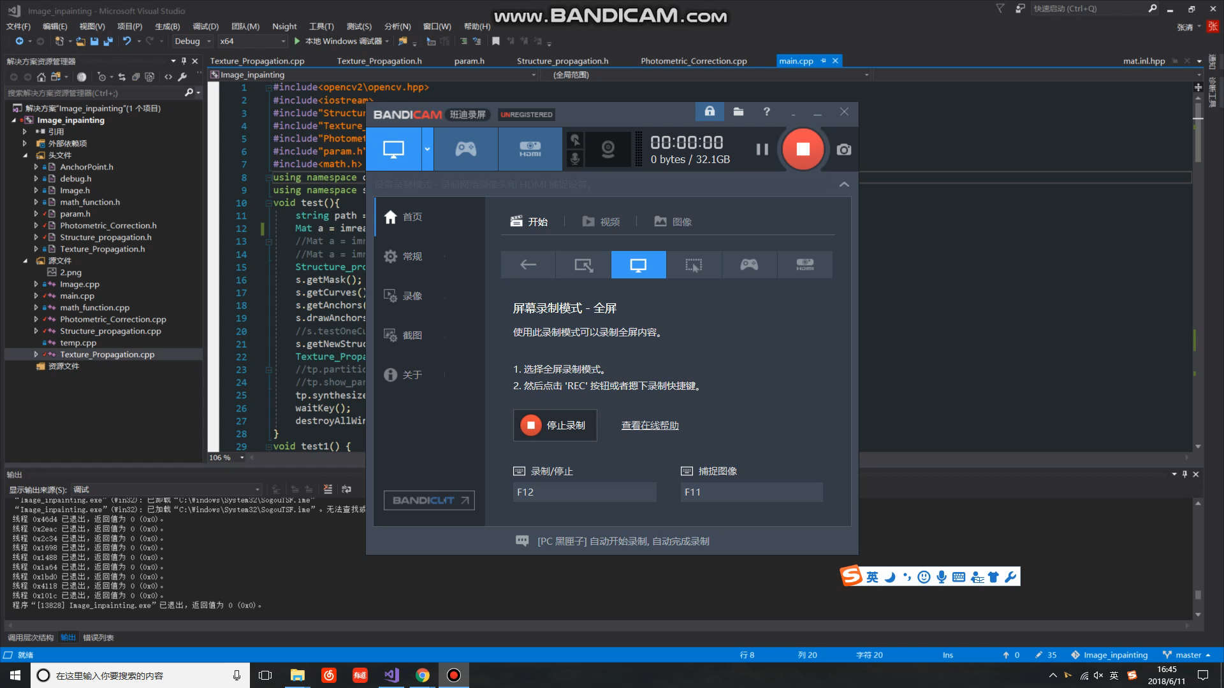

Slide 18
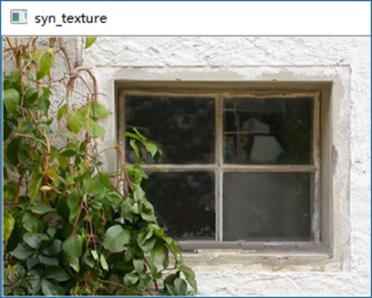


This case

Slide 19
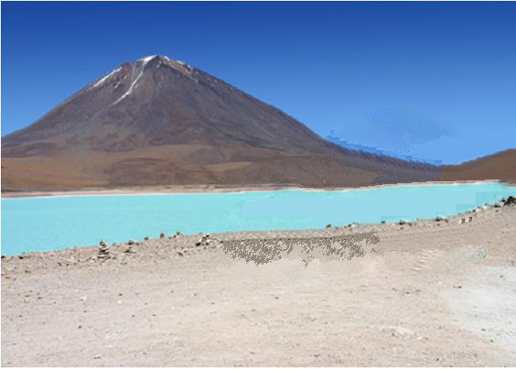
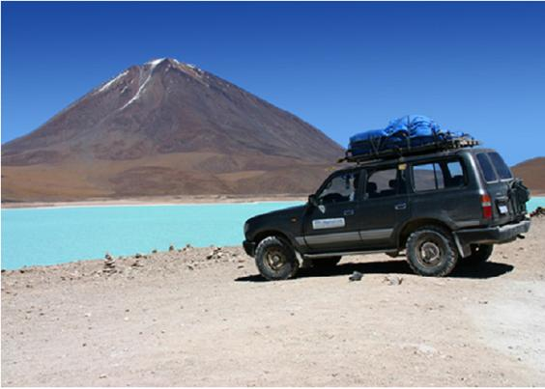
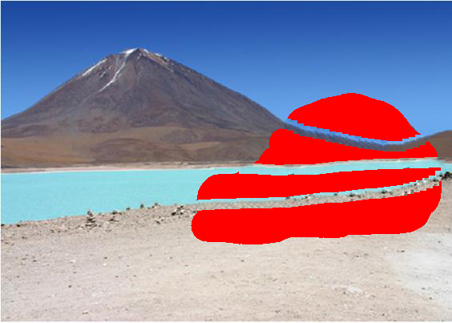
Another case

Slide 20


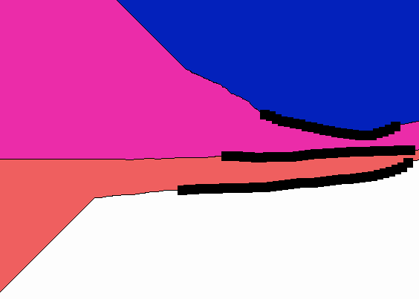
Another case

Slide 21
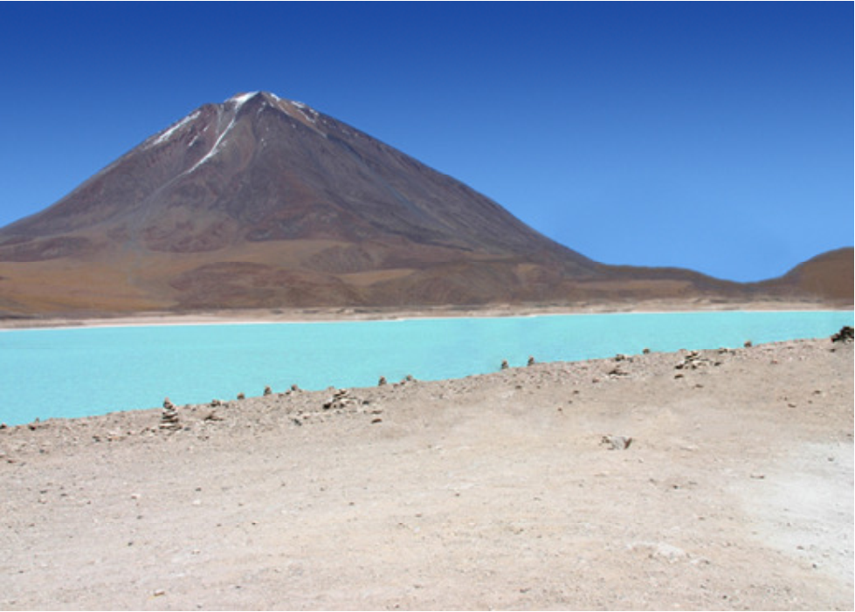
Comparison

Slide 22
Problems and conclusions

Slide 23

Problems and conclusions
The sample patches are not enough
1. Sample transformation
2.Reduce the distance between anchor points

Slide 24
Problems and conclusions
Try using Texture-by-numbers
——in Image Analogies

Slide 25
THANK YOU

